Slide 1

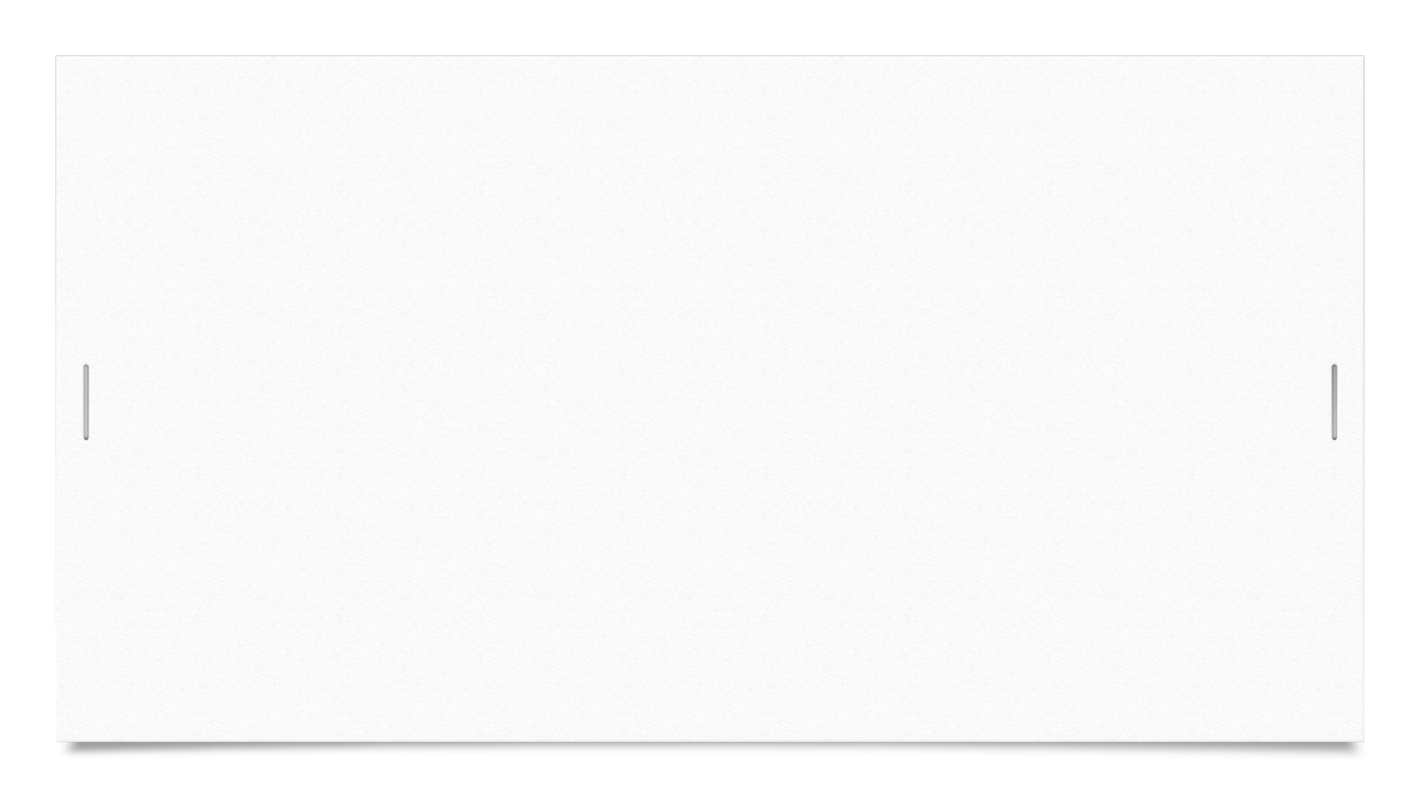


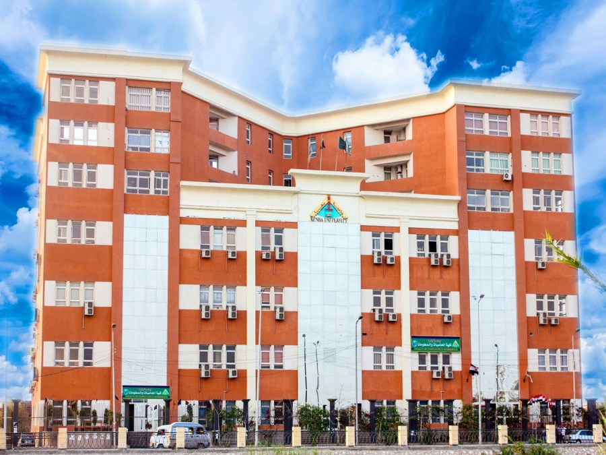
Restaurant management system
By order of:-
DR/Shimaa arafa
Directed by:-
Mohamed Salah Eldin Eraqi. Sec:13
Mohamed Saeed Mohamed Azzam. Sec:13
Mahmoud Mohamed Mohamed Abdelwahed. Sec:15
Mahmoud Mounir Elshhat Ali. Sec:15
Mohamed Ibrahim Eldsoky Moustafa. Sec:12

Slide 2
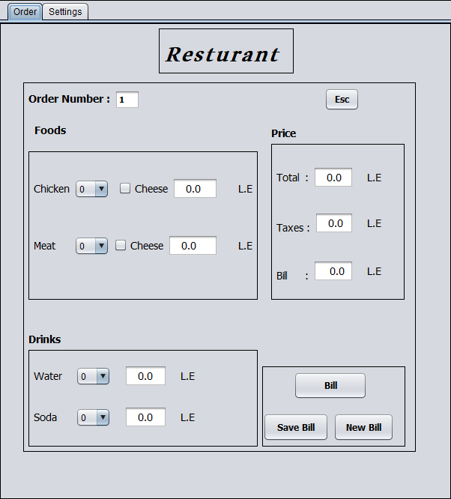
This window is controlled by the manager of the restaurant hall where he receives the order from the customer and give him the bill we will Explain this window in the next slides.
Project

Slide 3
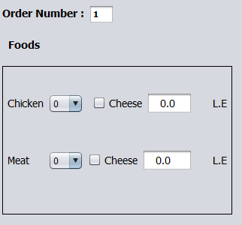
In front of us is the restaurant's menu of chicken and meat with the possibility of adding cheese and there is also the possibility to show the price.
Order

Slide 4
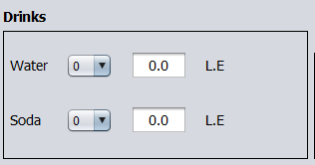
We have a list of drinks containing water and soda with the possibility of the price.
Order

Slide 5
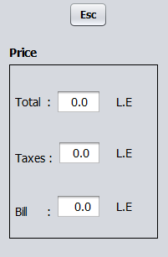
We have a price list that contains the total price of orders and there is a tax value and then the bill after the tax is added addition as there are also Esc buttons to get out of the program.
Order

Slide 6
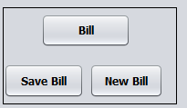
The (Bill) button sits on the renewal of the price list, The button(New Bill) increases 1 in the value of the order number and the work of a new order and button (Save Bill) inserts the order into the tables in the window of the sitting.
Order

Slide 7
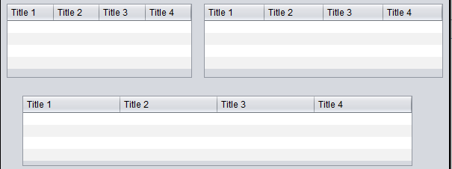
These are the tables where the program receives a (Save Bill) order to save the bill data.
Sittings

Slide 8
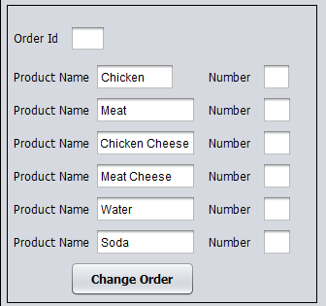
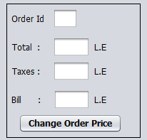
(Change Order) and (Change Order Price) enable the user to edit the order after saving it.
Sittings

Slide 9

(Show All Data) displays all the devices saved and (New Day) buttons delete the data stored in the tables to start a new day.
Sittings

Slide 10
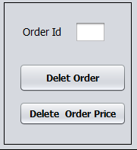
(Delete Order) and (Delete Order Price) buttons can delete one row of tables depending on the order ID.
Sittings

Slide 11
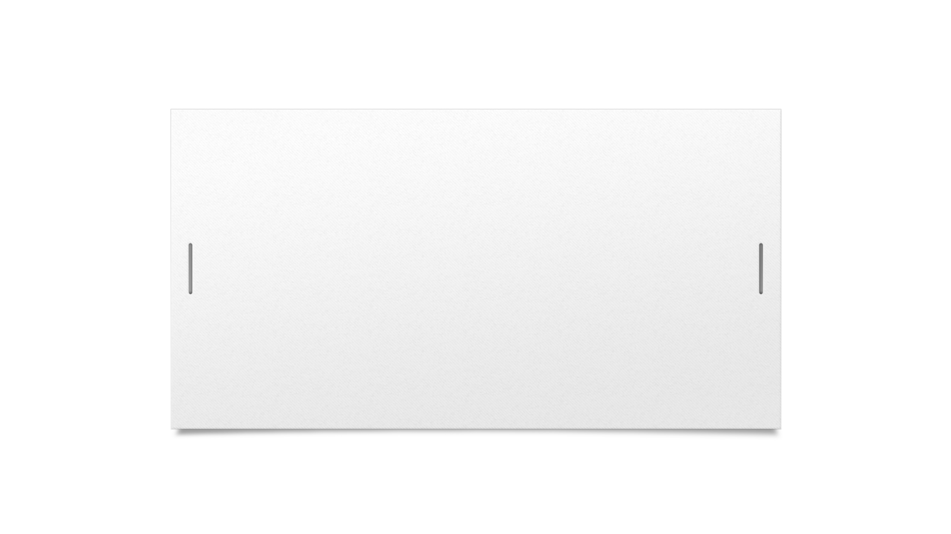

Thanks for your time

